Slide 1

Team Name –
Cookie Bytes
Theme –Algorithms and Data Structure
Shashwat Goyal
Aman Patel
Manish Kumar Singh
Rajnikant Mishra

Slide 2
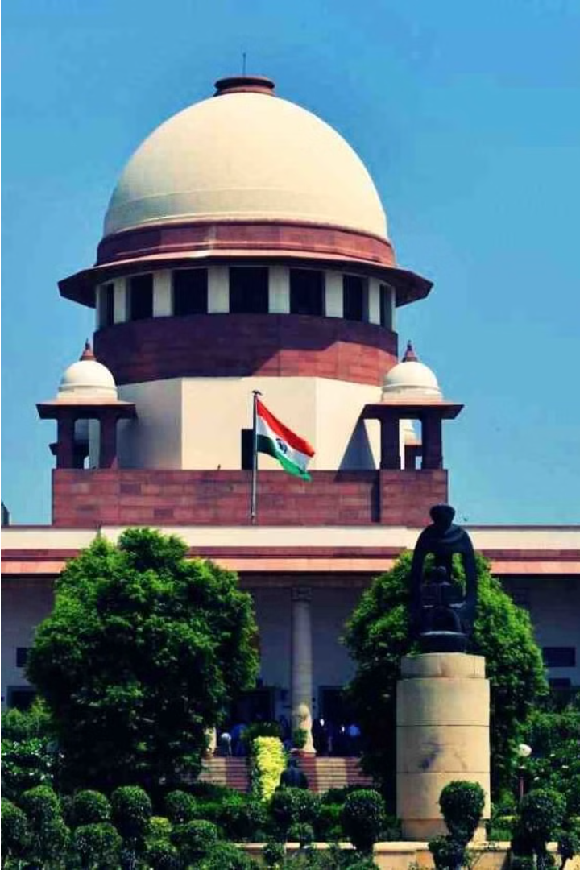
Problem Statement :-
Tech -Driven Solution for Undertrial Hearing In India
India's justice system faces a critical challenge with a large backlog of undertrial cases, leading to overcrowded prisons and delayed justice. This section explores tech-driven solutions to streamline case management and ensure timely resolutions.

Slide 3
Leveraging Technology for Case Management
E-Filing System
Digital Record Keeping
Streamline submission of case documents
Maintain centralized database of case files
Automated Scheduling
Optimize hearing and trial scheduling
Case Prioritization
Clearing Backlog Campaign:
Develop a criteria for prioritizing cases based on urgency , complexity and potential impact
Launch a targeted effort to clear out old cases , possibly through a special initiative or task force .

Slide 4
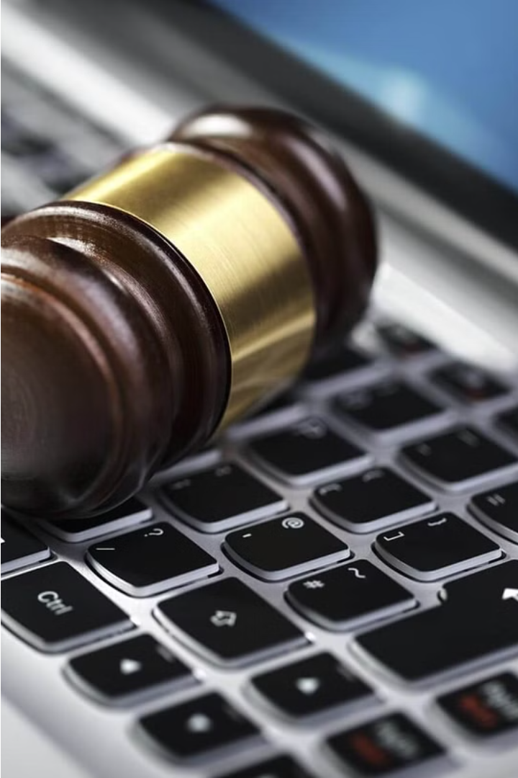
Digitizing Court Proceedings and Records
Streamlining operations through comprehensive digital transformation of case files, court transcripts, and legal documents.
Secure cloud-based storage and easy retrieval of all court records, enabling efficient case management and research.
Seamless integration of video conferencing technology for remote court hearings, reducing delays and improving access.

Slide 5
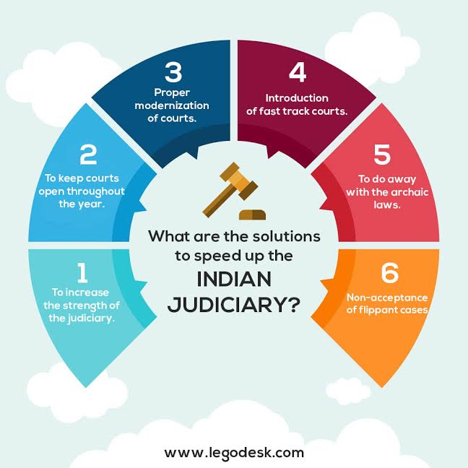
Streamlining Bail and Hearing Processes
1
Bail Application
Streamline the bail application process through online submission and automated review.
2
Hearing Scheduling
Leverage digital calendars to efficiently schedule hearings and minimize delays.
3
Remote Appearances
Enable remote participation in hearings to improve accessibility and reduce travel.

Slide 6
Predictive Analytics for Efficient Case Scheduling
1
Forecasting Case Volumes
2
Optimized Scheduling
Analyze historical data to predict upcoming caseloads
Match judicial resources to projected case needs
3
Early Intervention
4
Continuous Improvement
Identify high-risk cases for proactive management
Refine models based on actual outcomes

Slide 7




Enhancing Legal Representation and Access to Justice
Legal Representation
Access to Justice
Legal Literacy
Tech-Enabled Access
Empowering prisoners to navigate the legal system.
Educating undertrials on their rights and procedures.
Providing free/low-cost legal aid for undertrials.
Leveraging technology for virtual hearings and case filing.

Slide 8
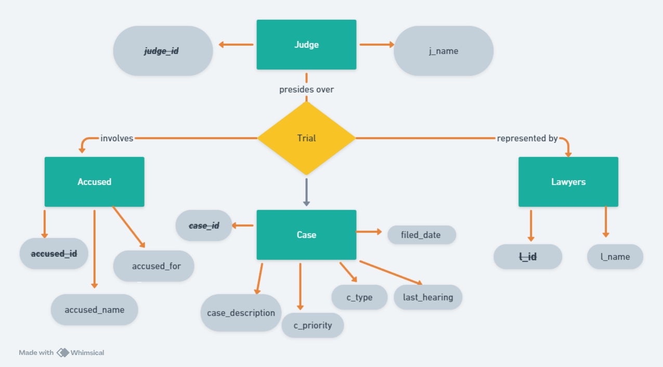

Slide 9
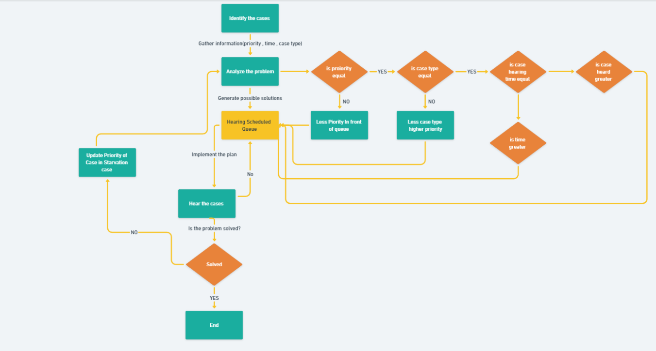

Slide 10
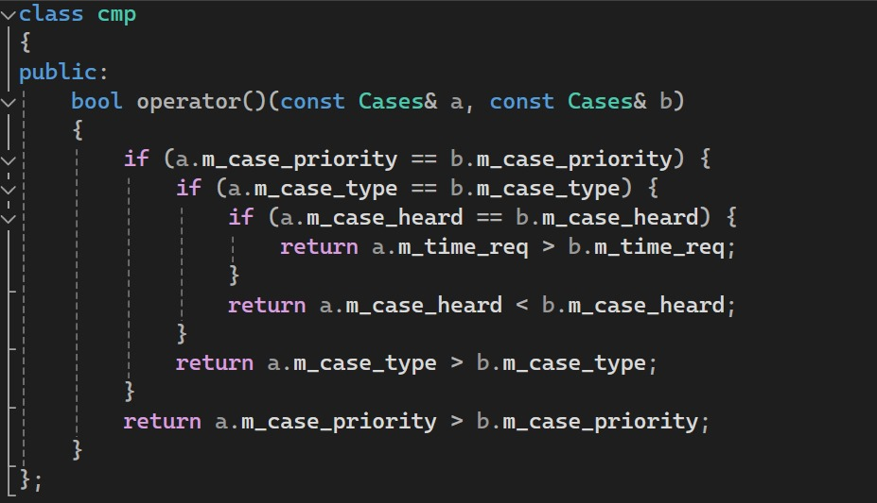

Slide 11
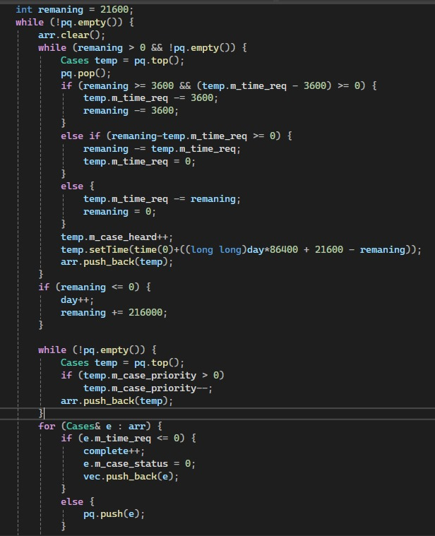

Slide 12
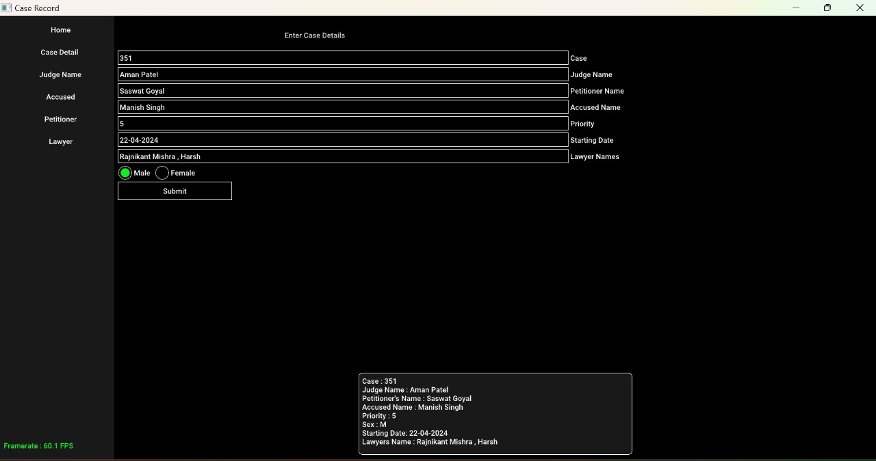

Slide 13

Conclusion: Toward a More Equitable and Efficient Justice System
By leveraging technology, we can transform India's justice system to be more equitable and efficient. Digitized records and streamlined processes will reduce case backlogs.
Predictive analytics can optimize scheduling, while improved communication and transparency will enhance access to justice for all. Together, these innovations can create a fairer, more accessible legal system.

Slide 14



Conclusion: Toward a More Equitable and Efficient Justice System
Enhanced Transparency
1
Increased visibility into case status and proceedings
Improved Accessibility
2
Streamlined, user-friendly platforms for all stakeholders
3
Reduced Delays
Efficient scheduling and case management
By leveraging technology-driven solutions, we can work toward a more equitable and efficient justice system for undertrial prisoners in India. Enhanced transparency, improved accessibility, and reduced delays will empower all stakeholders - from the courts to the incarcerated individuals - to navigate the legal process with greater ease and confidence. This holistic approach will help ensure that the fundamental rights and human dignity of undertrial prisoners are upheld, while also improving the overall effectiveness of the justice system.

Slide 15
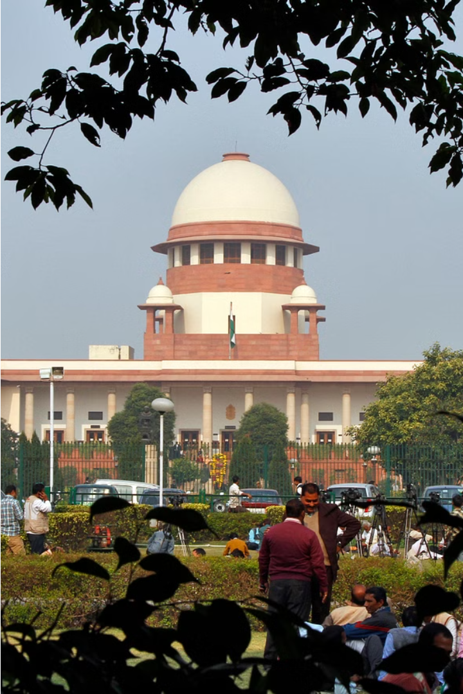
Conclusion: Toward a More Equitable and Efficient Justice System
Leveraging technology to reduce undertrial prisoner backlog and ensure fair, timely justice.

